Slide 1
High Resolution Gamma-Ray Spectroscopy
Owen Bell-Davies and Marawan Adam
Objectives:
To understand the apparatus used in high-resolution gamma-ray spectroscopy using a germanium detector.
To measure and understand the efficiency of a gamma-ray detector with standard sources.
To investigate the radioactive isotopes present in a series of samples using the detection of gamma-rays.

Slide 2
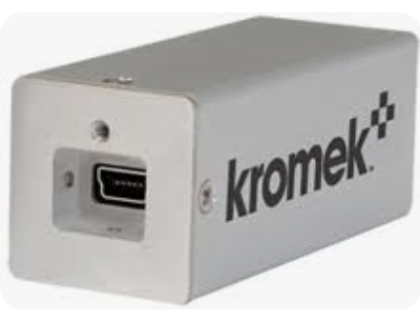
CZT detector
Cadmium-Zinc-Telluride
Electric Bias
Room temperature!
5 and 10 cm away!
Not very good!

Slide 3
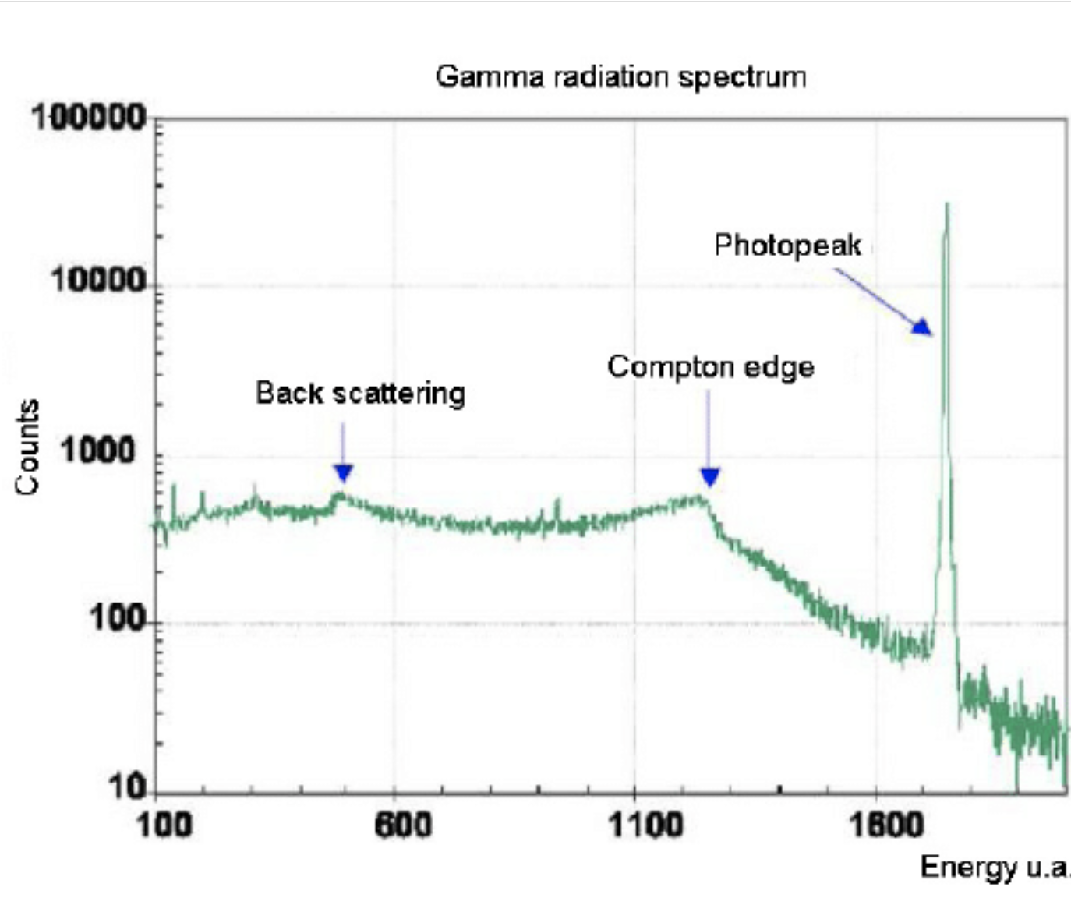
Gamma Spectrum Features
Photopeak
Compton continuum
Backscatter peaks
Compton edge

Slide 4
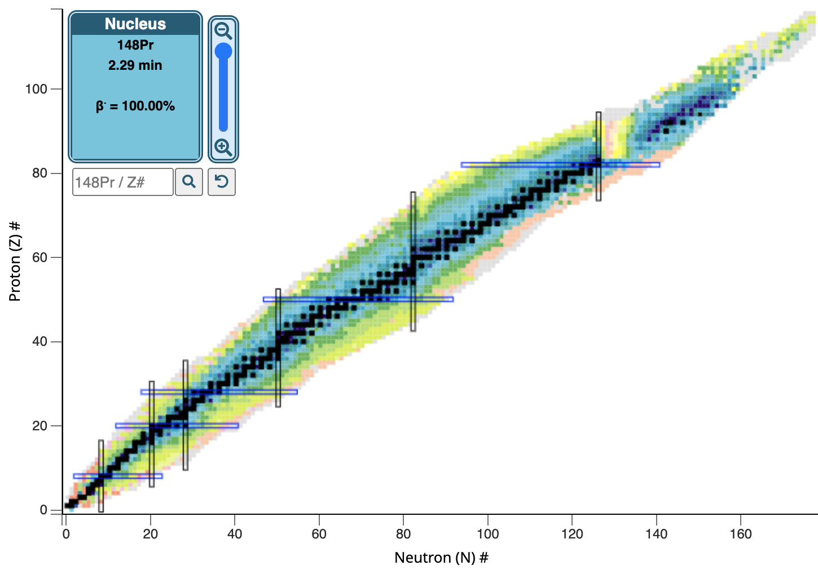
NuDat3

Slide 5
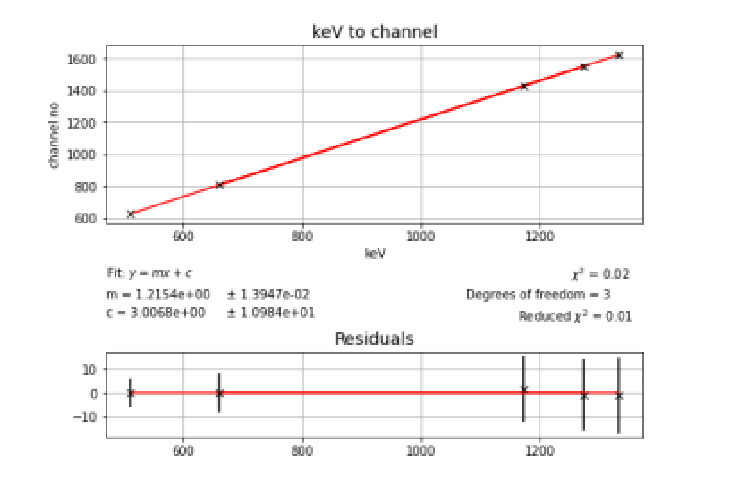
Interface and calibration

Slide 6
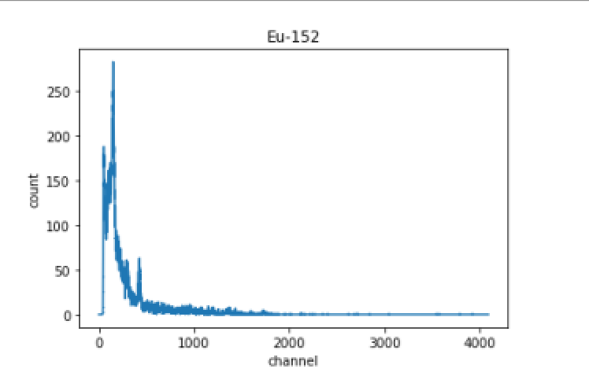
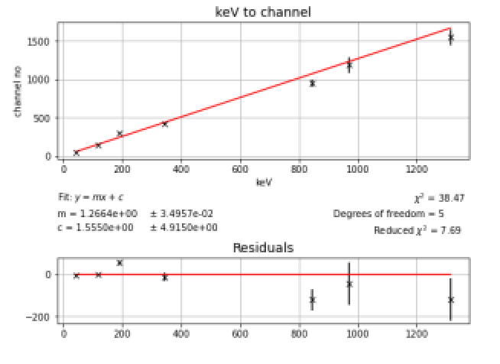
Eu-152 calibration

Slide 7
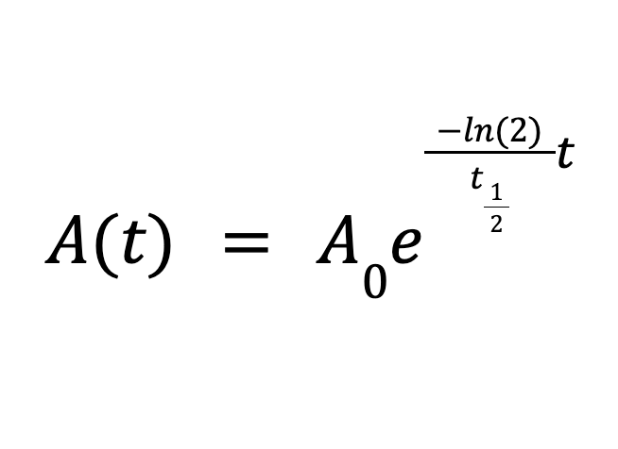
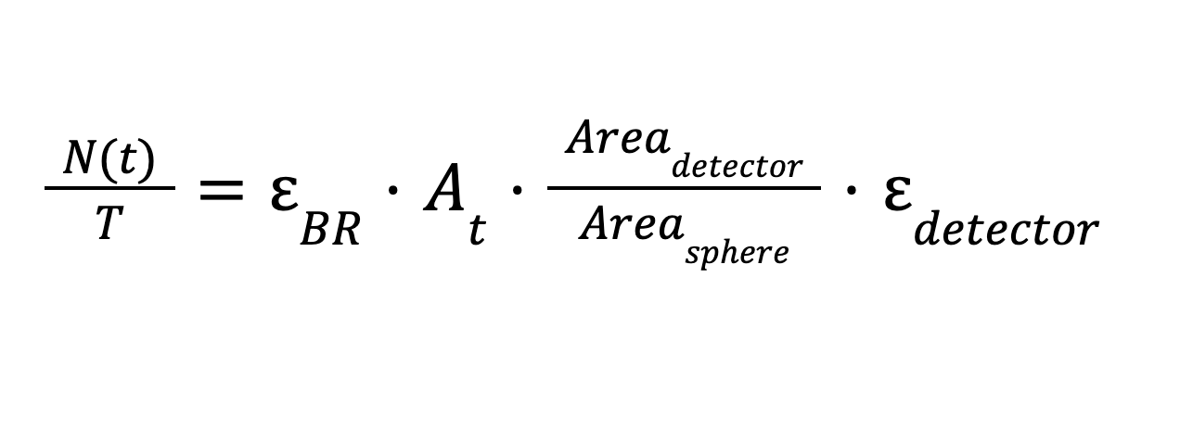
Intensity

Slide 8
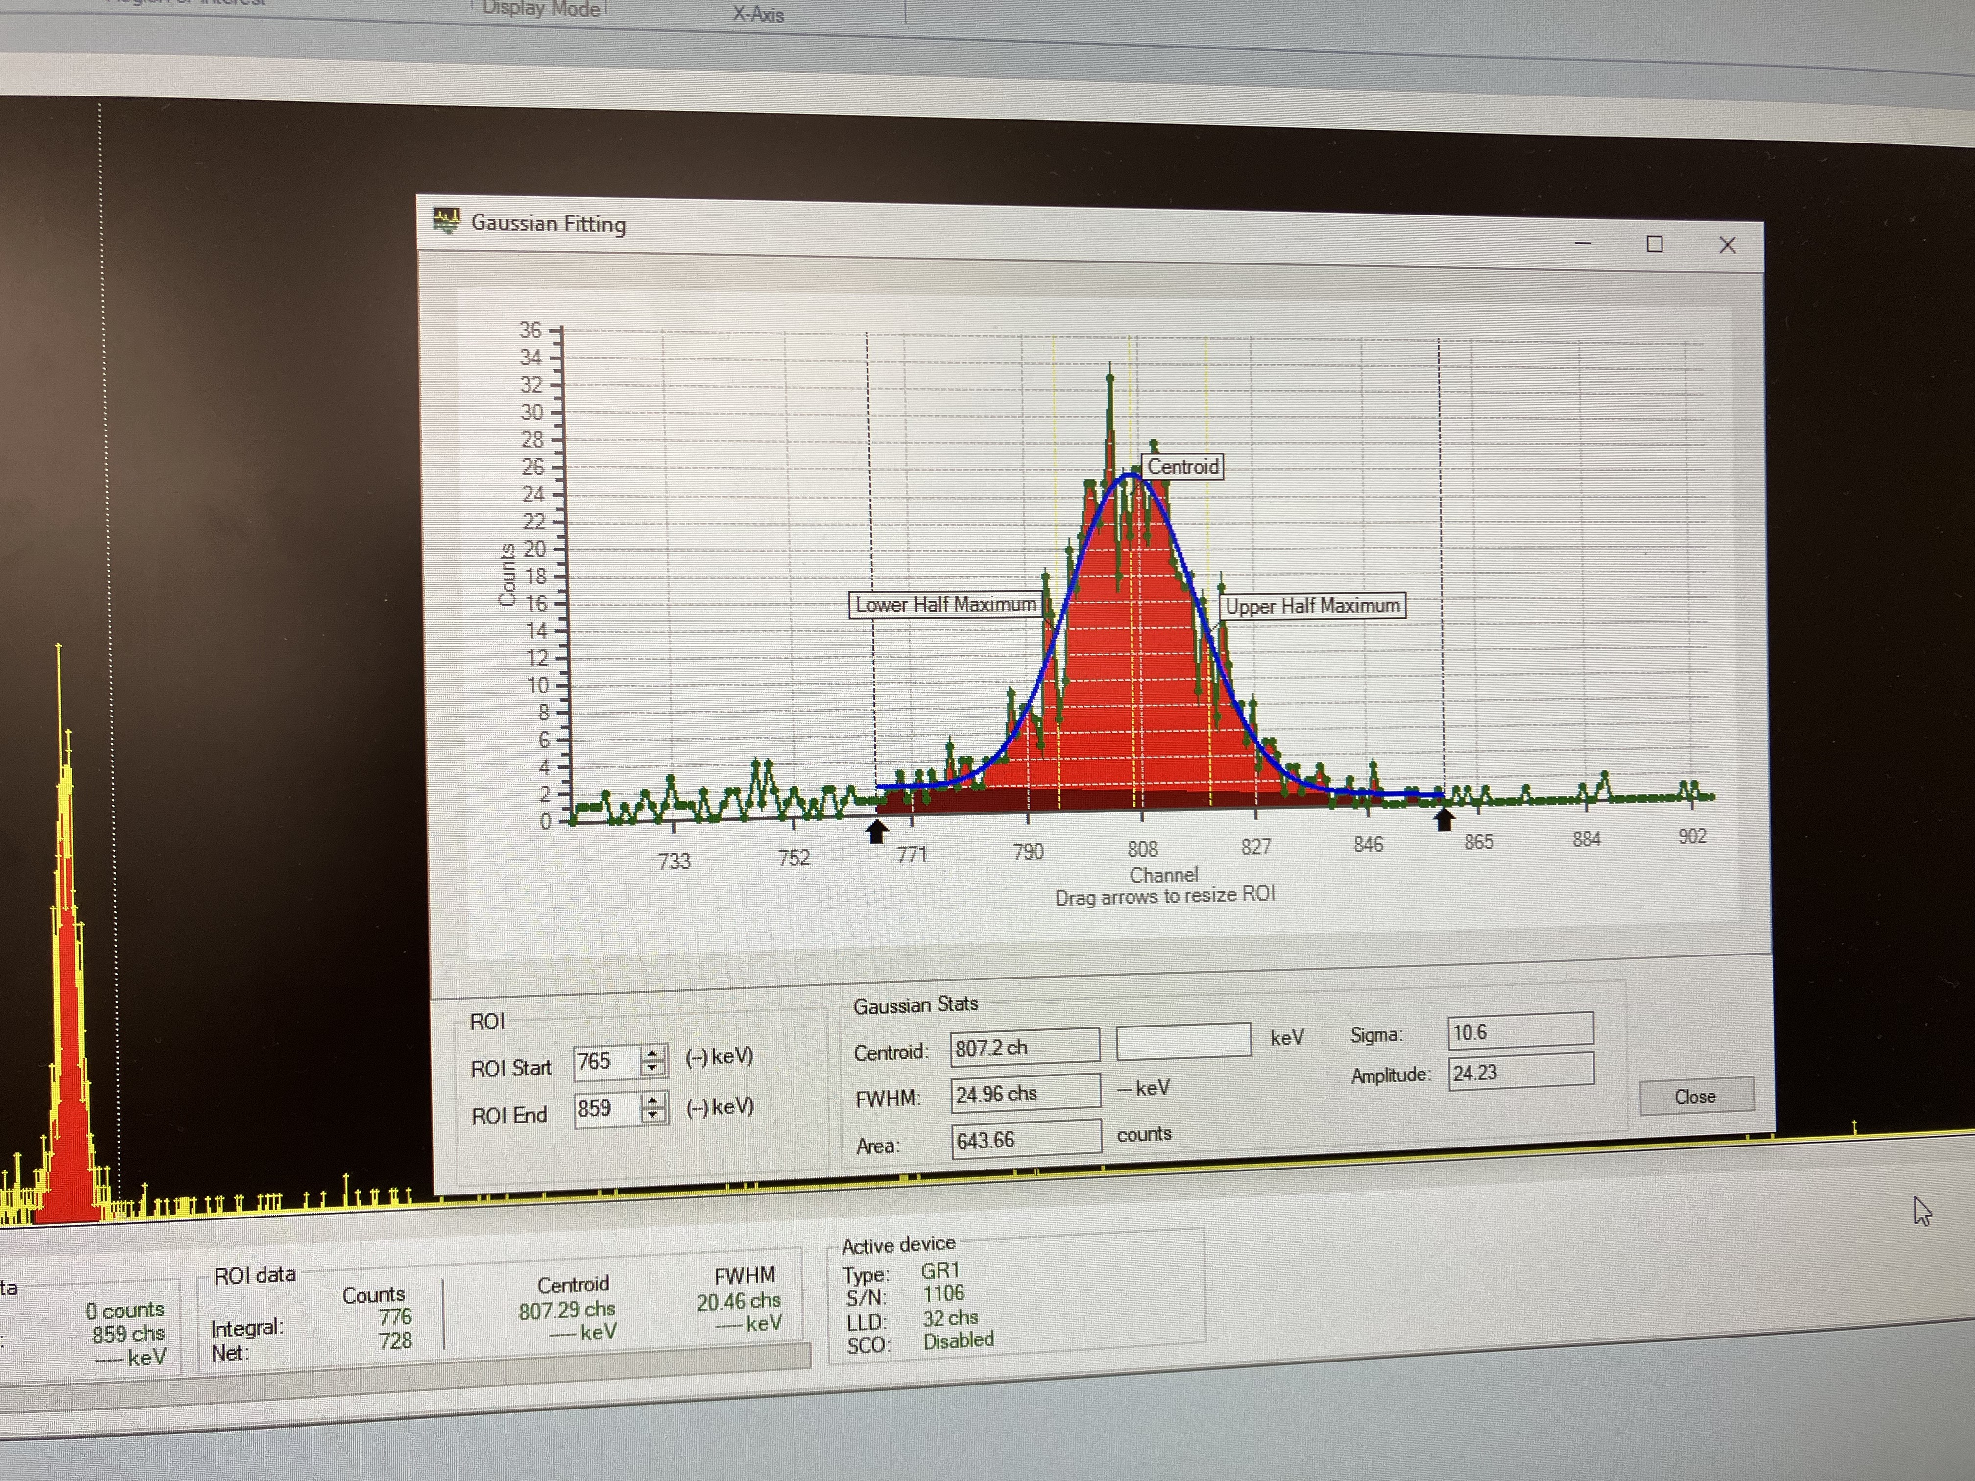
Intensity from graph

Slide 9
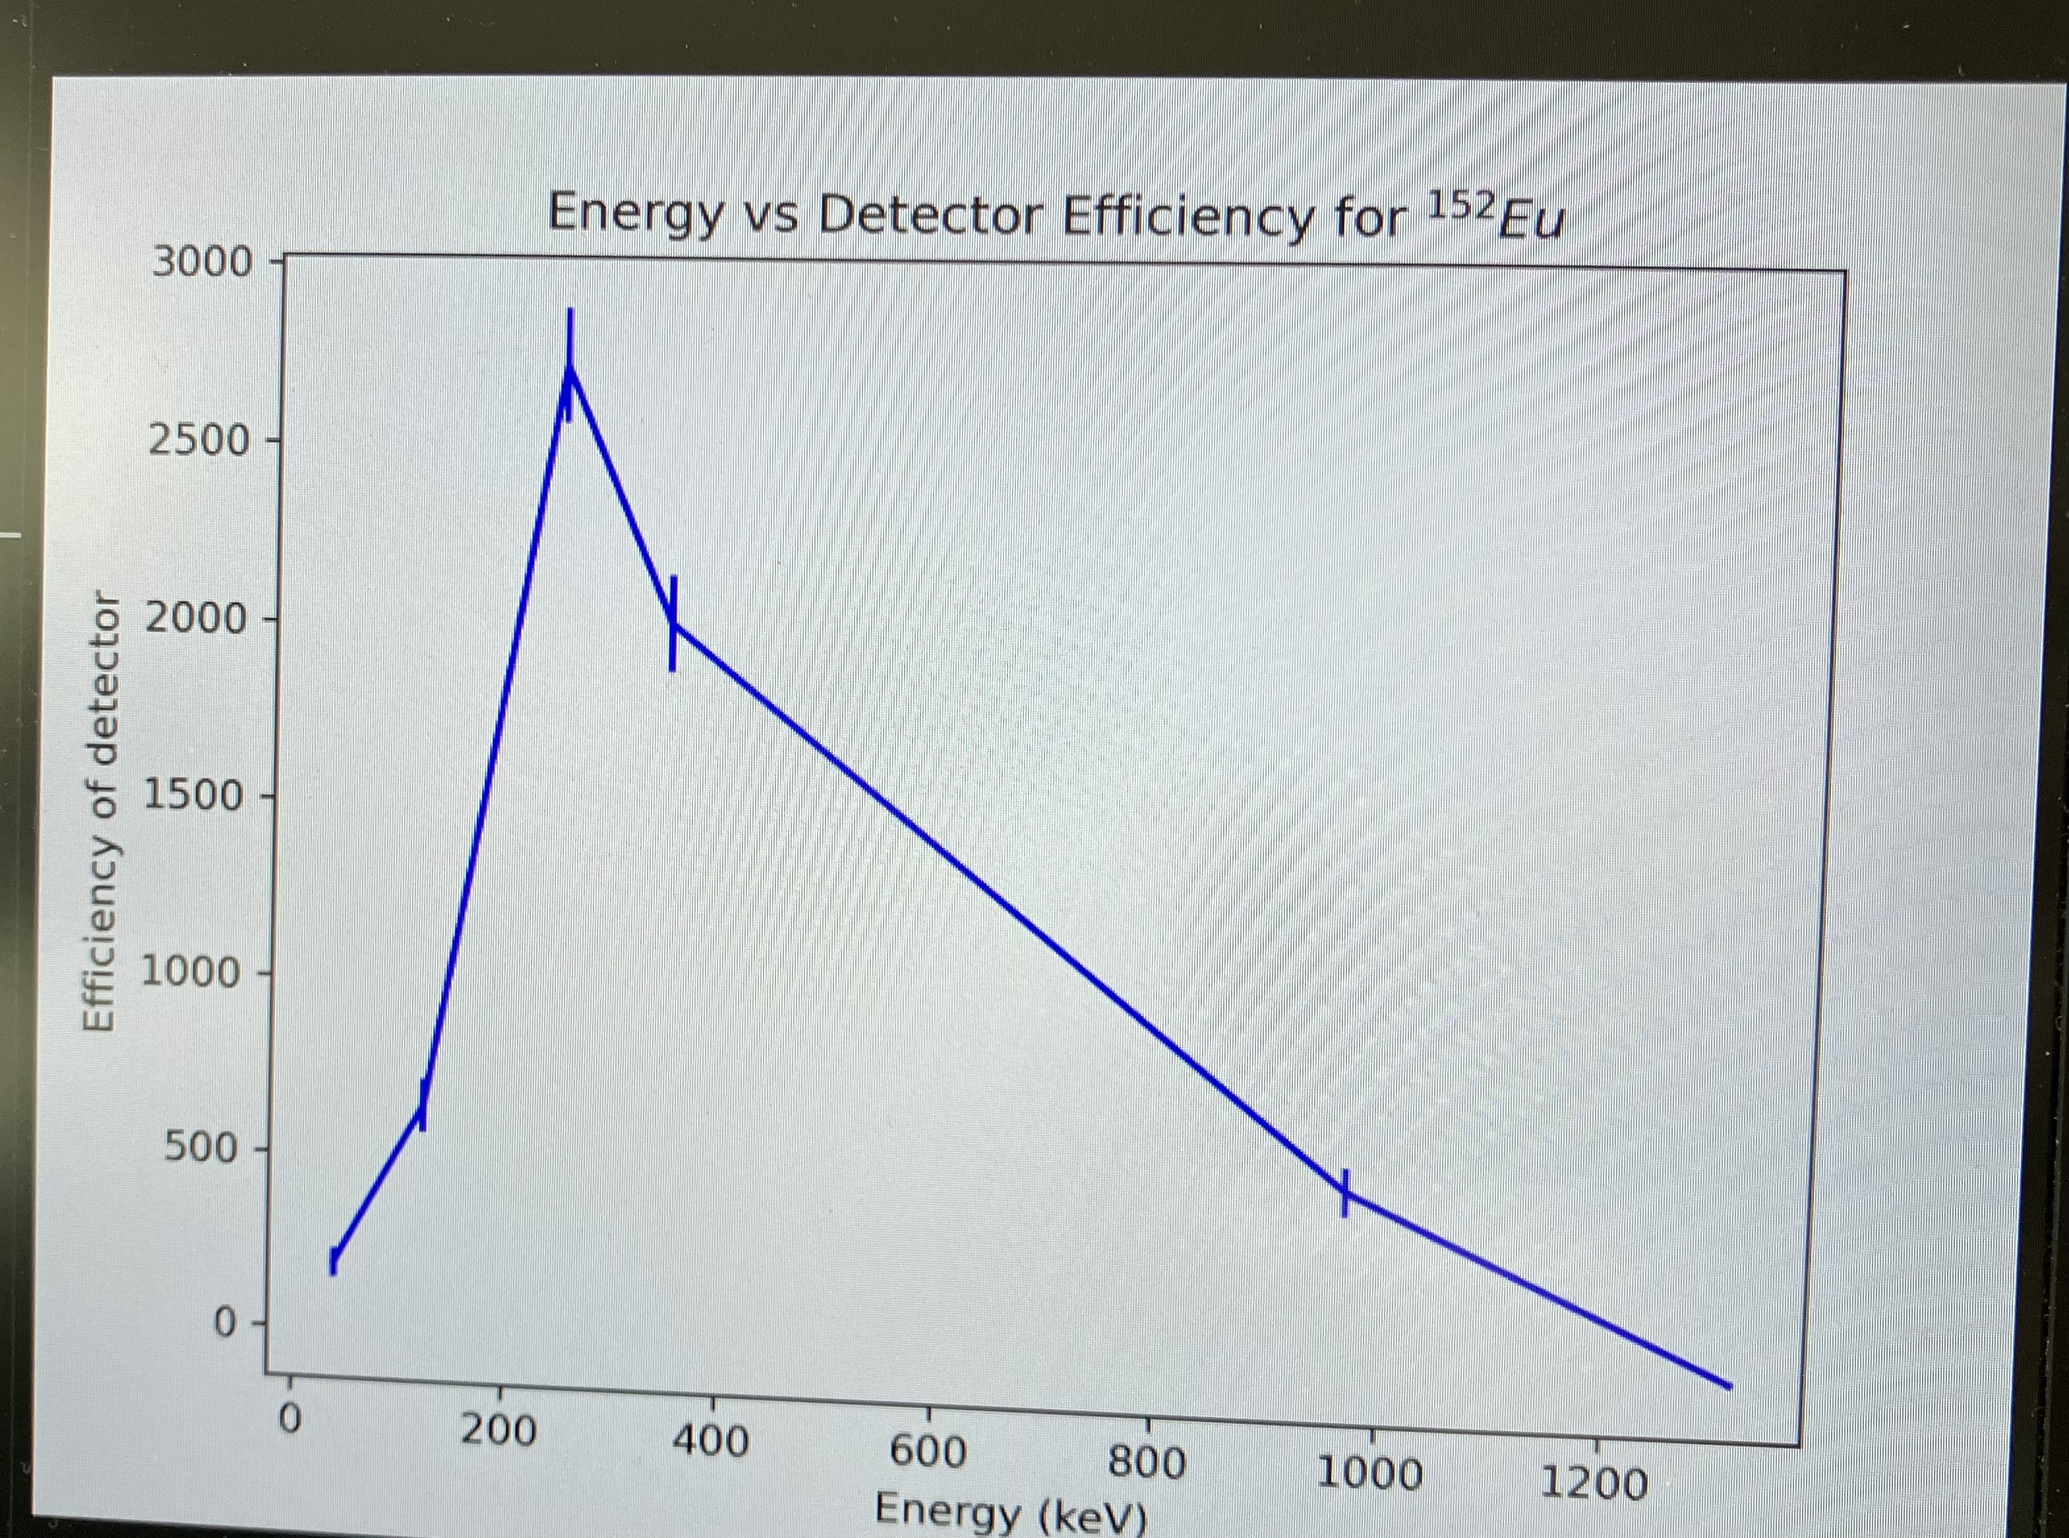

Slide 10
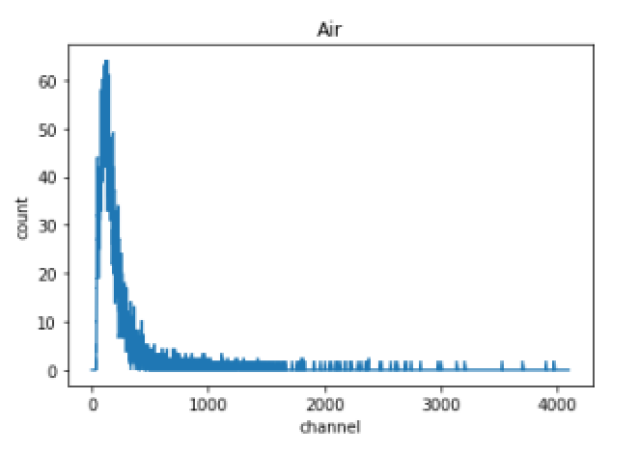
Sample searching

Slide 11
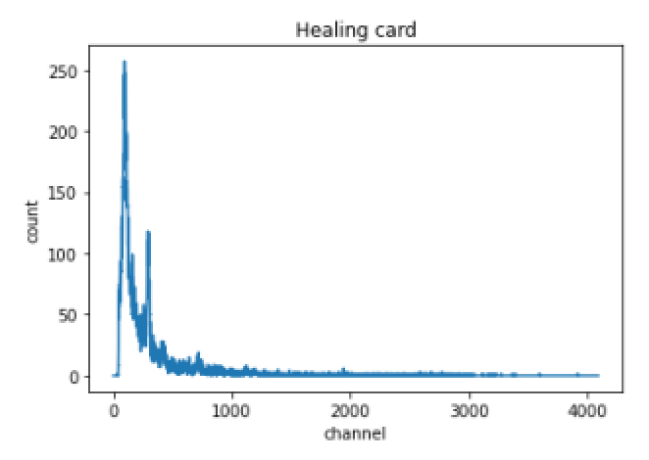

Slide 12
